Slide 1
HULL FORM AND GEOMETRY
Chapter 2

Slide 2
Intro to Ships and Naval Engineering (2.1)
Factors which influence design:
  Size
  Speed
  Payload
  Range
  Seakeeping
  Maneuverability
  Stability
  Special Capabilities (Amphib, Aviation, ...)
Compromise is required!

Slide 3
Classification of Ship by Usage
Merchant Ship
Naval & Coast Guard Vessel
Recreational Vessel
Utility Tugs
Research & Environmental Ship
Ferries

Slide 4
Categorizing Ships (2.2)
Methods of Classification:
  Physical Support:
      Hydrostatic
      Hydrodynamic
      Aerostatic (Aerodynamic)

Slide 5
Categorizing Ships

Slide 6
Classification of Ship by Support Type
Aerostatic Support
- ACV
- SES (Captured Air Bubble)
Hydrodynamic Support (Bernoulli)
- Hydrofoil
- Planning Hull
Hydrostatic Support (Archimedes)
- Conventional Ship
- Catamaran
- SWATH
- Deep Displacement
Submarine
- Submarine
- ROV

Slide 7
Aerostatic Support
Vessel rides on a cushion of air. Lighter weight, higher speeds, smaller load capacity.
  Air Cushion Vehicles - LCAC: Opens up 75% of littoral coastlines, versus about 12% for displacement
  Surface Effect Ships - SES: Fast, directionally stable, but not amphibious

Slide 8
Aerostatic Support
Supported by cushion of air
ACV
hull material : rubber
propeller : placed on the deck
amphibious operation
SES
side hull : rigid wall(steel or FRP)
bow : skirt
propulsion system : placed under the water
water jet propulsion
supercavitating propeller
(not amphibious operation)

Slide 9
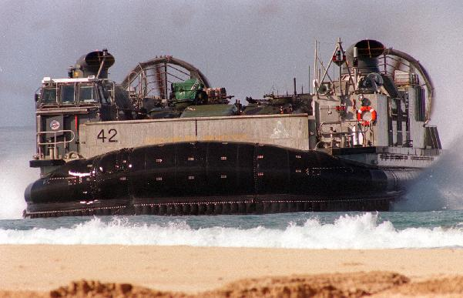
Aerostatic Support

Slide 10
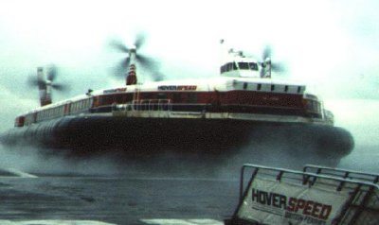
Aerostatic Support
English Channel Ferry - Hovercraft

Slide 11
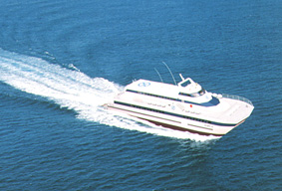
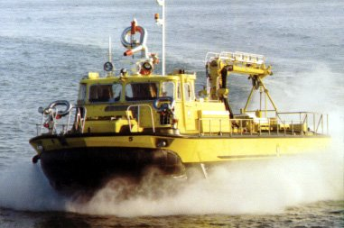
Aerostatic Support
SES Ferry
NYC SES Fireboat
E

Slide 12
Hydrodynamic Support
Supported by moving water. At slower speeds, they are hydrostatically supported
  Planing Vessels - Hydrodynamics pressure developed on the hull at high speeds to support the vessel. Limited loads, high power requirements.
  Hydrofoils - Supported by underwater foils, like wings on an aircraft. Dangerous in heavy seas. No longer used by USN.

Slide 13
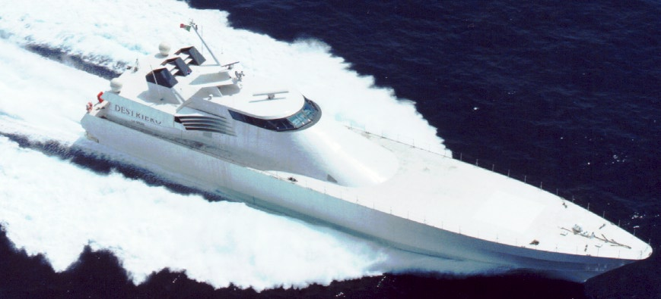
Hydrodynamic Support
Planing Hull
supported by the hydrodynamic pressure developed under a hull at high speed
“V” or flat type shape
- Commonly used in pleasure boat, patrol boat, missile boat, racing boat
Destriero

Slide 14
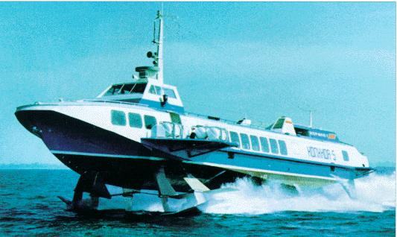
Hydrodynamic Support
Hydrofoil Ship
- supported by a hydrofoil, like wing on an aircraft
- fully submerged hydrofoil ship
- surface piercing hydrofoil ship
Hydrofoil Ferry

Slide 15
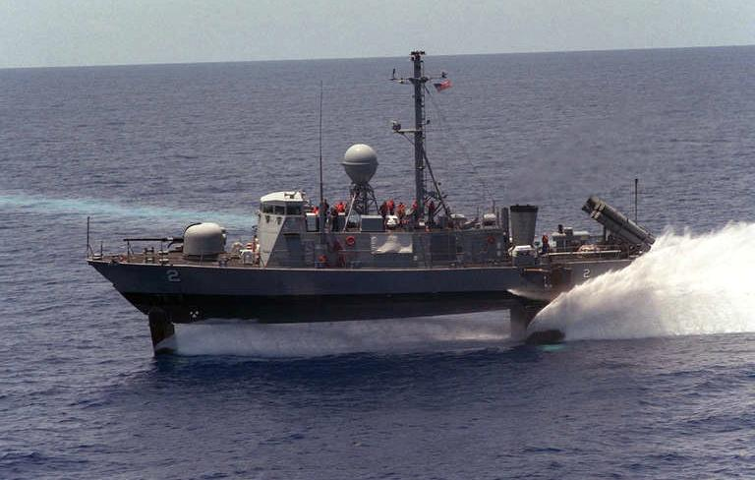
Hydrodynamic Support

Slide 16
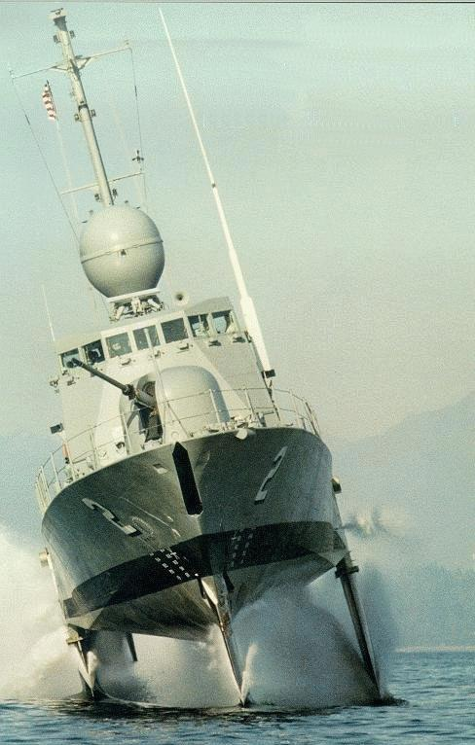
Hydrodynamic Support

Slide 17
Hydrostatic Support
Displacement Ships Float by displacing their own weight in water
  Includes nearly all traditional military and cargo ships and 99% of ships in this course
  Small Waterplane Area Twin Hull ships (SWATH)
  Submarines (when surfaced)

Slide 18
Hydrostatic Support
The Ship is supported by its buoyancy.
(Archimedes Principle)
Archimedes Principle : An object partially or fully submerged in a fluid will experience a resultant vertical force equal in magnitude to the weight of the volume of fluid displaced by the object.
The buoyant force of a ship is calculated from the
displaced volume by the ship.

Slide 19
Hydrostatic Support
Mathematical Form of Archimedes Principle
Resultant Weight
Resultant Buoyancy

Slide 20
Hydrostatic Support
Displacement ship
- conventional type of ship
- carries high payload
- low speed
SWATH
- small waterplane area twin hull (SWATH)
- low wave-making resistance
- excellent roll stability
- large open deck
- disadvantage : deep draft and cost
Catamaran/Trimaran
- twin hull
- other characteristics are similar to the SWATH
Submarine

Slide 21
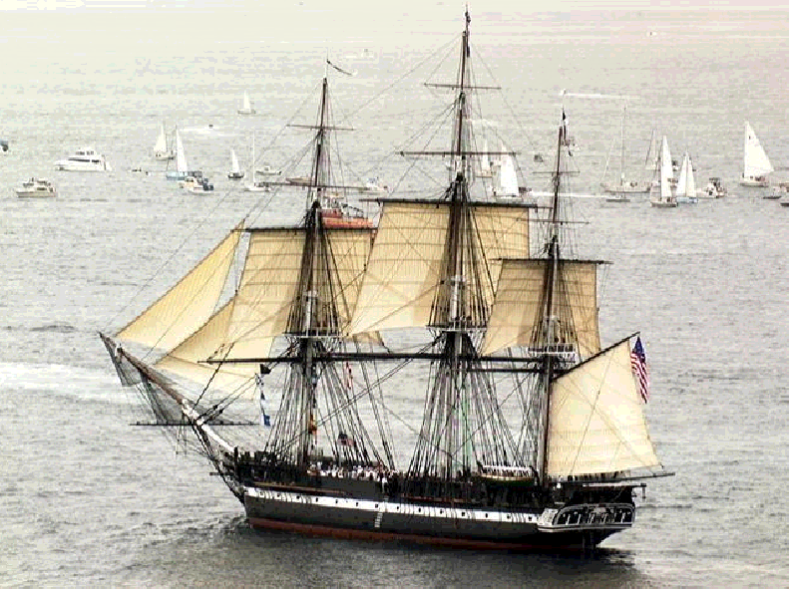
Hydrostatic Support

Slide 22
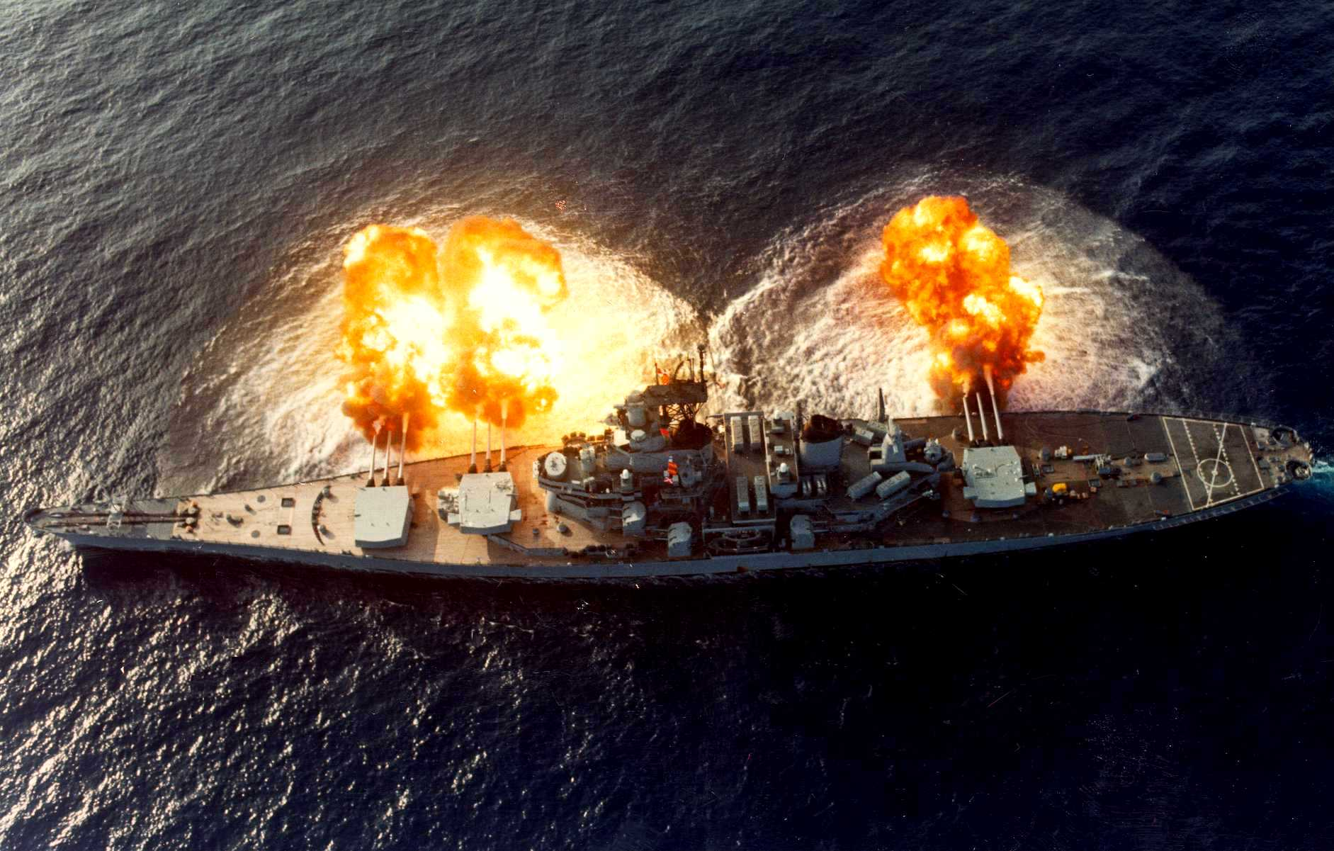
Hydrostatic Support

Slide 23
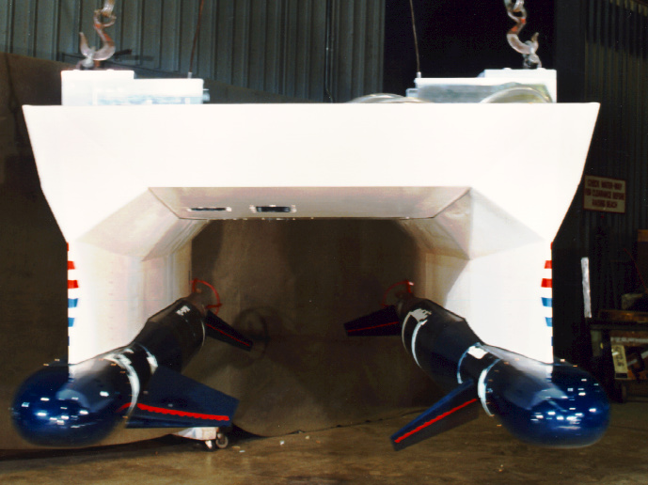
Hydrostatic Support

Slide 24
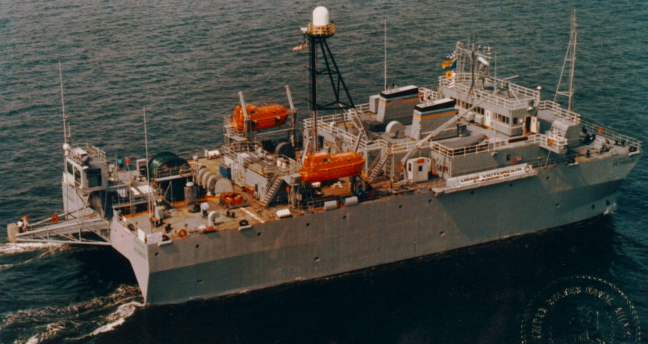
Hydrostatic Support

Slide 25
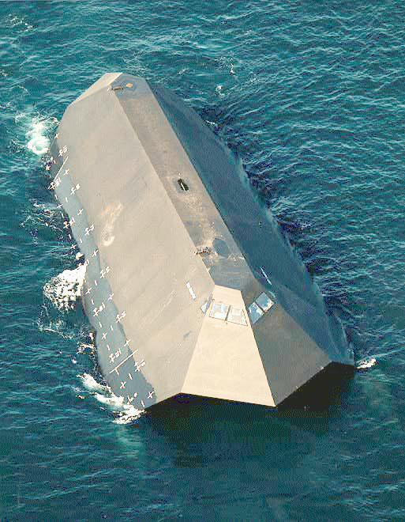
Hydrostatic Support

Slide 26
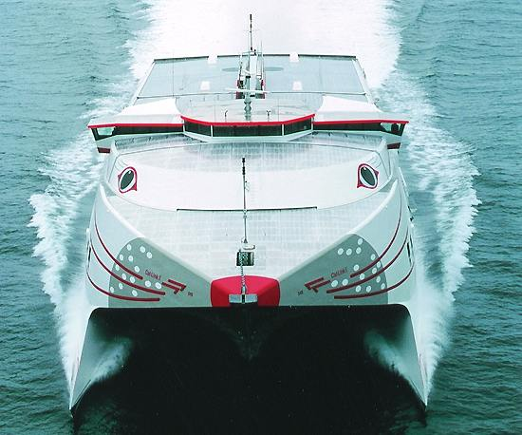
Hydrostatic Support

Slide 27
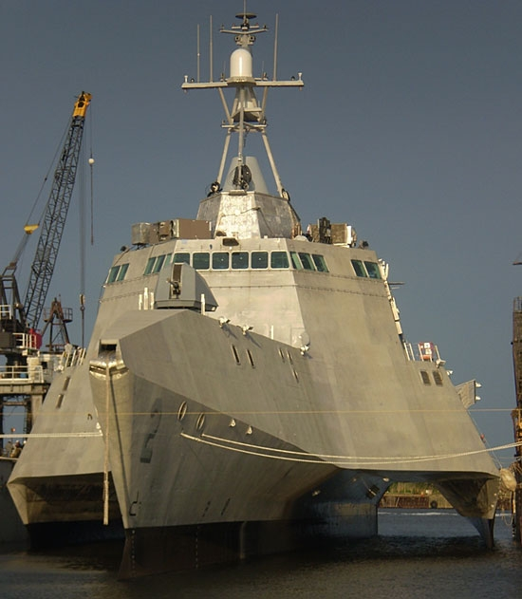
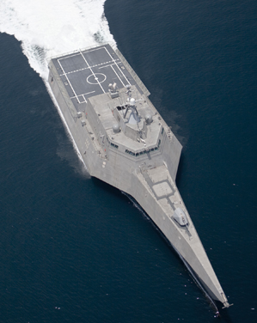
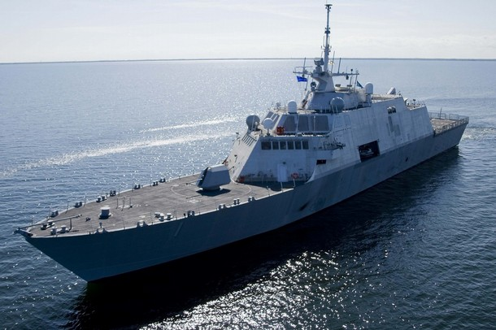
Hydrostatic Support

Slide 28
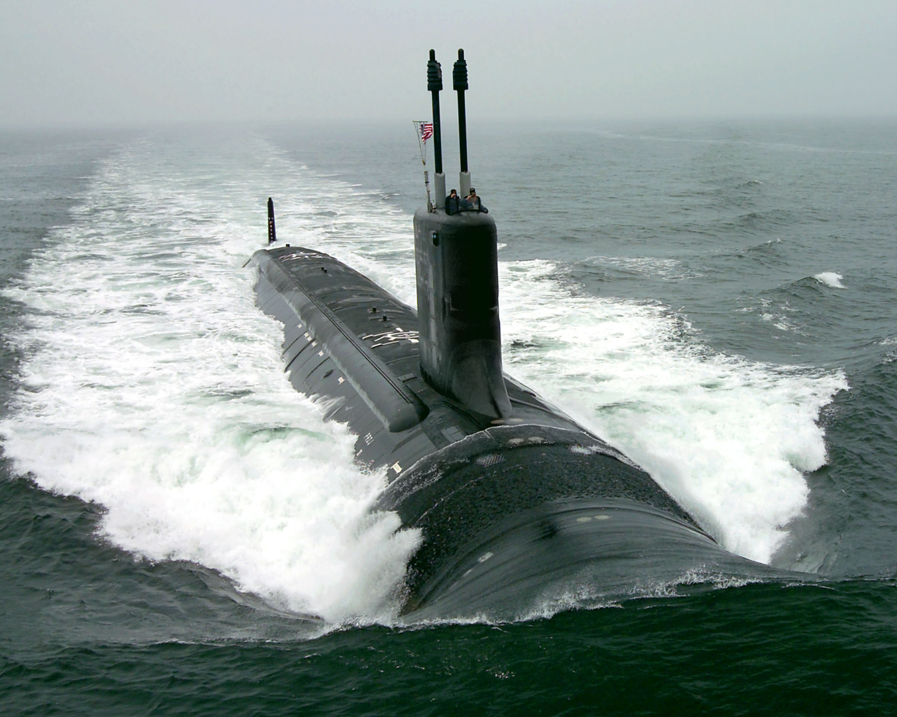
Hydrostatic Support

Slide 29
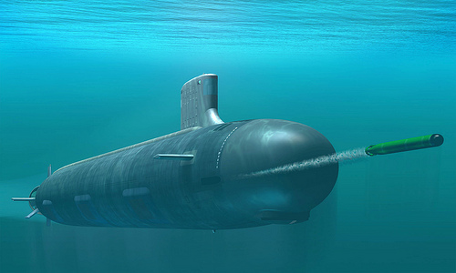

Slide 30
2.3 Ship Hull Form and Geometry
The ship is a 3-dimensional shape:
Data in x, y, and z directions is necessary to represent the ship hull.
Table of Offsets
Lines Drawings:
- body plan (front View)
- shear plan (side view)
- half breadth plan (top view)

Slide 31
Hull Form Representation
Lines Drawings:
Traditional graphical representation of the ship’s hull form…… “Lines”
Half-Breadth
Sheer Plan
Body Plan

Slide 32
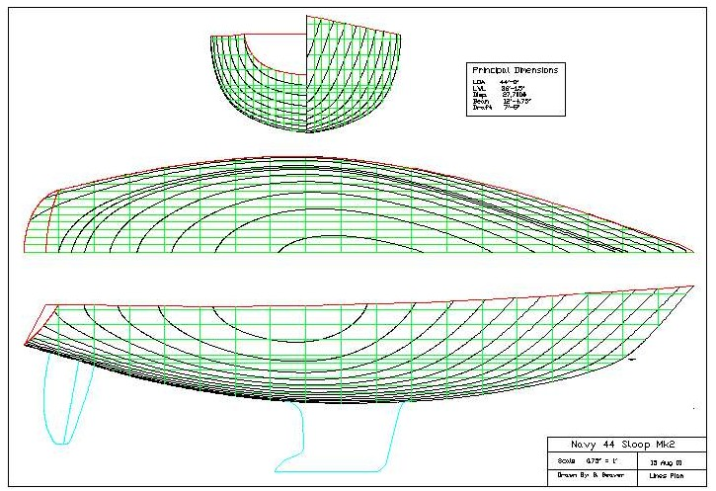
Hull Form Representation
Body Plan
(Front / End)
Half-Breadth Plan
(Top)
Sheer Plan
(Side)
Lines Plan

Slide 33
Half-Breadth Plan
- Intersection of planes (waterlines) parallel to the baseline (keel).

Slide 34
Sheer Plan
-Intersection of planes (buttock lines) parallel to the centerline plane

Slide 35
Body Plan
- Intersection of planes to define section line
- Sectional lines show the true shape of the hull form
- Forward sections from amidships : R.H.S.
- Aft sections from amid ship : L.H.S.

Slide 36
Table of Offsets (2.4)
Used to convert graphical information to a numerical representation of a three dimensional body.
Lists the distance from the center plane to the outline of the hull at each station and waterline.
There is enough information in the Table of Offsets to produce all three lines plans.

Slide 37
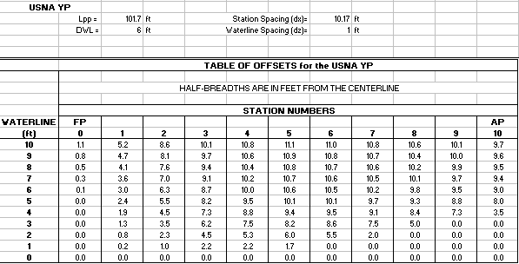
Table of Offsets
The distances from the centerplane are called the offsets or half-breadth distances.

Slide 38
2.5 Basic Dimensions and Hull Form Characteristics
FP
AP
Shear
DWL
Lpp
LOA
LOA(length over all ) : Overall length of the vessel
DWL(design waterline) : Water line where the ship is designed to float
Stations : parallel planes from forward to aft, evenly spaced (like bread).Normally an odd number to ensure an even number of blocks.
FP(forward perpendicular) : imaginary vertical line where the bow intersects
the DWL
AP(aft perpendicular) : imaginary vertical line located at either the rudder
stock or intersection of the stern with DWL

Slide 39
Basic Dimensions and Hull Form Characteristics
FP
AP
Shear
DWL
Lpp
LOA
Lpp (length between perpendicular) : horizontal distance from FP and AP
Amidships : the point midway between FP and AP ( ) Midships Station
Shear : longitudinal curvature given to deck

Slide 40
Basic Dimensions and Hull Form Characteristics
Beam: B
Camber
View of midship section
WL
Freeboard
Depth: D
Draft: T
K
C
L
Depth(D): vertical distance measured from keel to deck taken at amidships and deck edge in case the ship is cambered on the deck.
Draft(T) : vertical distance from keel to the water surface
Beam(B) : transverse distance across the each section
Breadth(B) : transverse distance measured amidships

Slide 41
Basic Dimensions and Hull Form Characteristics
Beam: B
Camber
View of midship section
WL
Freeboard
Depth: D
Draft: T
K
C
L
Freeboard : distance from depth to draft (reserve buoyancy)
Keel (K) : locate the bottom of the ship
Camber : transverse curvature given to deck

Slide 42
Basic Dimensions and Hull Form Characteristics
Flare
Tumblehome
Flare : outward curvature of ship’s hull surface above the waterline
Tumble Home : opposite of flare

Slide 43
Example Problem
Label the following:
R. Distance between “N.” & “O.”
___=______ _______ ______________
I. Viewed from
this direction
____-_______ Plan
G. Viewed from
this direction
____ Plan
P. Middle ref plane for
longitudinal measurements
_________
z
S. Width of the ship
____
A.(translation)
_____
E. (rotation)
_____/____
C. (translation)
_____
x
Q. Longitudinal ref plane for
transverse measurements
__________
N. Forward ref plane for
longitudinal measurements
_______ _____________
J. _______ Line
M. Horizontal ref plane for
vertical measurements
________
O. Aft ref plane for
longitudinal measurements
___ _____________
H. Viewed from
this direction
_____ Plan
D. (rotation)
____/____/____
y
B. (translation)
____
L. _____line
F. (rotation)
___
K. _______ Line

Slide 44
Example Answer
Label the following:
R. Distance between “N.” & “O.”
LBP=Length between Perpendiculars
P. Middle ref plane for
longitudinal measurements
Amidships
I. Viewed from
this direction
Half-Breadth Plan
G. Viewed from
this direction
Body Plan
z
S. Width of the ship
Beam
A.(translation)
Surge
E. (rotation)
Pitch/Trim
C. (translation)
Heave
x
Q. Longitudinal ref plane for
transverse measurements
Centerline
N. Forward ref plane for
longitudinal measurements
Forward Perpendicular
J. Section Line
M. Horizontal ref plane for
vertical measurements
Baseline
O. Aft ref plane for
longitudinal measurements
Aft Perpendicular
H. Viewed from
this direction
Sheer Plan
D. (rotation)
Roll/List/Heel
y
B. (translation)
Sway
L. Waterline
F. (rotation)
Yaw
K. Buttock Line

Slide 45
2.6 Centroids
Centroid
- Area
- Mass
- Volume
- Force
- Buoyancy(LCB or TCB)
- Floatation(LCF or TCF)
Apply the Weighed Average Scheme or Σ Moment =0

Slide 46
Centroids
Centroid – The geometric center of a body.
Center of Mass - A “single point” location of the mass.
  … Better known as the Center of Gravity (CG).
CG and Centroids are only in the same place for uniform (homogenous) mass!

Slide 47
Centroids
Centroids and Center of Mass can be found by using a weighted average.

Slide 48
Centroid of Area
y
x2
x1
y3
x3
y1
y2
x

Slide 49
Centroid of Area Example
y
8ft²
3ft²
5ft²
4
2
3
7
2
2
x

Slide 50
Centroid of Area
Proof
y
b
A_{T}
h
x
x₁
dx
x
Since the moment created by differential area dA is , total moment
which is called 1st Moment of Area is calculated by integrating the whole area as,
Also moment created by total area A_{T} will produce a moment w.r.t y axis and can be written below. (recall Moment=force×moment arm)
The two moments are identical so that centroid of the geometry is
This eqn. will be used to determine LCF in this Chapter.

Slide 51
2.7 Center of Floatation & Center of Buoyancy
Center of Floatation
- Centroid of water plane (LCF varies depending on draft.)
- Pivot point for list and trim of floating ship
LCF: centroid of water plane from the amidships
TCF : centroid of water plane from the centerline
The Center of Flotation changes as the ship lists, trims, or changes draft because as the shape of the waterplane changes so does the location of the centroid.
LCF
centerline
TCF
In this case of ship,
LCF is at aft of amidship.
TCF is on the centerline.
Amidships

Slide 52
Center of Buoyancy
Centroid of displaced water volume
Buoyant force act through this centroid.
LCB: Longitudinal center of buoyancy from amidships
KB : Vertical center of buoyancy from the Keel
TCB : Transverse center of buoyancy from the centerline
Center of Buoyancy moves when the ship lists, trims or changes draft because the shape of the submerged body has changed thus causing the centroid to move.
TCB
LCB
Center
line
KB
Base line

Slide 53
Center of Buoyancy : B
B
2
centerline
1
WL
1
2
2
1
1
Buoyancy force (Weight of Barge)
LCB : at midship
TCB : on centerline
KB : T/2
Reserve Buoyancy Force
1
WL
1
B
T/2
C
L

Slide 54
2.8 Fundamental Geometric Calculation
Why numerical integration?
  - Ship is complex and its shape cannot usually be represented by a
  mathematical equation.
  - A numerical scheme, therefore, should be used to calculate the ship’s
  geometrical properties.
  - Uses the coordinates of a curve (e.g. Table of Offsets) to integrate
Which numerical method ?
- Rectangle rule
- Trapezoidal rule
- Simpson’s 1st rule (Used in this course)
- Simpson’s 2nd rule
Notes:
Approximation to the true integration.

Slide 55
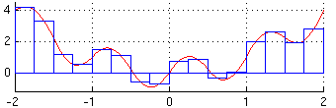
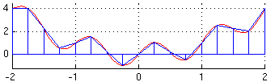
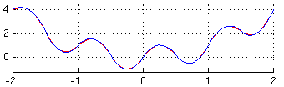
Rectangle rule
Trapezoidal rule
Simpson’s rule

Slide 56
Trapezoidal Rule
- Uses 2 data points
- Assumes linear curve
: y=mx+b
y4
y2
A1=s/2*(y1+y2)
A2=s/2*(y2+y3)
A3=s/2*(y3+y4)
y1
y3
A1
A2
A3
s
s
s
x1
x2
x3
x4
s = ∆x = x2-x1 = x3-x2 = x4-x3
Total Area = A1+A2+A3
= s/2 (y1+2y2+2y3+y4)

Slide 57
Simpson’s 1st Rule
- Uses 3 data points
- Assume 2nd order polynomial curve
Mathematical Integration
Numerical Integration
y
y
y(x)=ax²+bx+c
dx
y1
y2
y3
A
dA
A
x
x
s
s
x1
x2
x3
x1
x2
x3
(S=∆x)
Area :

Slide 58
Simpson’s 1st Rule
y
y7
y6
y8
y2
y5
y9
y1
y3
y4
s
x
x1
x2
x3
x4
x5
x6
x7
x8
x9
Odd number
Evenly spaced
Gen. Eqn.

Slide 59
Application of Numerical Integration
Application
- Waterplane Area
- Sectional Area
- Submerged Volume
- LCF
- VCB
- LCB
Scheme
- Simpson’s 1st Rule

Slide 60
2.9 Numerical Calculation
Calculation Steps
1. Start with a sketch of what you are about to integrate.
2. Show the differential element you are using.
3. Properly label your axis and drawing.
4. Write out the generalized calculus equation written in
the same symbols you used to label your picture.
5. Convert integral in Simpson’s equation.
6. Solve by substituting each number into the equation.

Slide 61
Section 2.9
See your “Equations and Conversions” Sheet
Waterplane Area
  A_{WP}=2∫y(x)dx; where integral is half breadths by station
Sectional Area
  A_{sect}=2∫y(z)dz; where integral is half breadths by waterline
(Half-Breadth Plan)
Y
y(x)
Half-
Breadths
(feet)
dx=Station Spacing
0
Stations
X
Z
(Body Plan)
dz=Waterline Spacing
Water
lines
y(z)
0
Y
Half-Breadths (feet)
0
Notes:
8

Slide 62
Section 2.9
See your “Equations and Conversions” Sheet
Submerged Volume
  V_{S}=∫A_{sect}dx; where integral is
  sectional areas by station
Longitudinal Center of Floatation
  LCF=(2/A_{WP})*∫xydx; where
  integral is product of distance
  from FP & half breadths by station
A_{sect}
A(x)
Sectional
Areas
(feet²)
dx=Station Spacing
0
Stations
X
Y
(Half-Breadth Plan)
y(x)
Half-
Breadths
(feet)
dx=Station Spacing
x
Stations
X
0
Notes:
8

Slide 63
Waterplane Area
y
y(x)
x
FP
dx
AP
Factor for symmetric waterplane area

Slide 64
Waterplane Area
Generalized Simpson’s Equation
y
x
FP
0
1
2
3
4
5
6
AP

Slide 65
Sectional Area
Sectional Area : Numerical integration of half-breadth
as a function of draft
z
WL
y(z)
T
dz
y

Slide 66
Sectional Area
Generalized Simpson’s equation
z
WL
8
6
Δz
T
4
2
y
0

Slide 67
Submerged Volume : Longitudinal Integration
Submerged Volume : Integration of sectional area over the length of ship
z
Scheme:
x
y

Slide 68
Submerged Volume
Sectional Area Curve
As
dx
x
FP
AP
Calculus equation
Generalized equation

Slide 69
A_{section}, A_{wp} , and submerged volume are examples of how Simpson’s rule is used to find area and volume…
… The next slides show how it can be used to find the centroid of a given area.
The only difference in the procedure is the addition of another
term, the distance of the individual area segments from the
y-axis…the value of x.
The values of x will be the progressive sum of the ∆x… if ∆x is
the width of the sections, say 10, then x₀=0, x₁=10, x₂=20,x₃=30…
and so on.

Slide 70
Longitudinal Center of Floatation(LCF)
LCF
- Centroid of waterplane area
- Distance from reference point to center of floatation
- Referenced to amidships or FP
- Sign convention of LCF
+
WL
-
+
FP

Slide 71
Longitudinal Center of Floatation (LCF)
y
y(x)
dA
x
FP
dx
AP
Weighted Average of Variable X (i.e. distance from FP)
Moment Relation

Slide 72
Longitudinal Center of Floatation(LCF)
y
y(x)
LCF
x
FP
dx
AP
LCF by weighted averaged scheme or Moment relation

Slide 73
Longitudinal Center of Floatation(LCF)
Generalized Simpson’s Equation
x₆
x₅
y
x₄
x₃
x₂
x₁
x
FP
0
1
2
3
4
5
6
AP

Slide 74
It’s often easier to put all the information in tabular form on
an Excel spreadsheet:
Remember, this gives only part of the equation!
….You still need the “2/A_{wp} x 1/3 Dx” part!
Dx here is 81.6 ft
A_{wp} would be given
“2” because you’re dealing with a half-breadth section

Slide 75
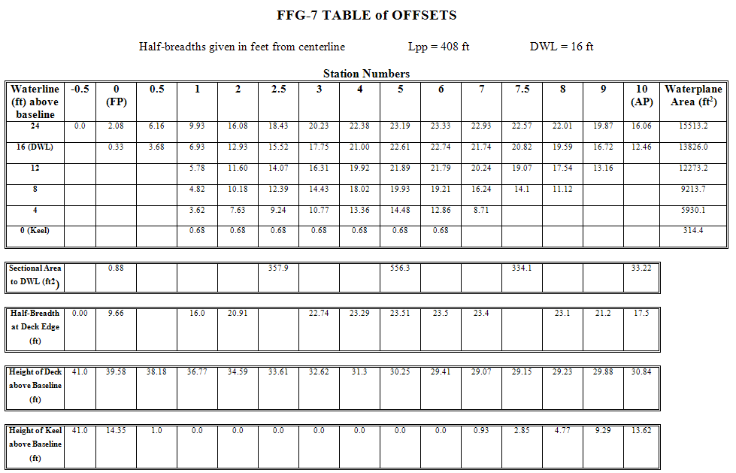

Slide 76
Vertical Center of Buoyancy, KB
This is similar to the LCF in that it is a CENTROID, but where LCF is the centroid
of the A_{wp}, KB is the centroid of the submerged volume of the ship measured from the keel…
z
y
A_{wp}
KB
x
where:
- A_{wp} is the area of the waterplane at the distance z from the keel
- z is the distance of the A_{wp} section from the x-axis
- dz is the spacing between the A_{wp} sections, or Dz in Simpson’s Eq.

Slide 77
You can now put this into Simpson’s Equation:
KB =1/3 dz [(1) (z_{o}) (A_{wpo}) + 4 (z₁) (A_{wp1}) + 2 (z₂) (A_{wp2}) +… + (z_{n}) (A_{wpn}) ]/
underwater hull volume
Remember that the blue terms are what we have to add to make Simpson work for KB.
Don’t forget to include them in your calculations!

Slide 78
And FINALLY,…
Longitudinal Center of Buoyancy, LCB
This is EXACTLY the same as KB, only this time:
- Instead of taking measurements along the z-axis, you’re taking them from the x-axis
- Instead of using waterplane areas, you’re using section areas
- It’ll tell you how far back from the FP the center of buoyancy is.
z
y
A_{section}
x
LCB
where:
- A_{sect} is the area of the section at the distance z from the forward perpendicular (FP)
- x is the distance of the A_{sect} section from the y-axis
- dx is the spacing between the A_{sect} sections, or Dx in Simpson’s Eq.

Slide 79
You can now put this into Simpson’s Equation:
LCB = 1/3 dx [(1) (x_{o}) (A_{sect}) + 4 (x₁) (A_{sect 1}) + 2 (x₂) (A_{sect 2}) +… + (x_{n}) (A_{sect n}) ] /
underwater hull volume
Remember that the blue terms are what we have to add to make Simpson work for LCB.
Don’t forget to include them in your calculations!

Slide 80
And that is Simpson’s Equations as they apply to this course!
Remember:
The concept of finding the center of an area, LCF, or the center of a volume, LCB or KB, are just centroid equations. Understand THAT concept, and you can find the center of any shape or object!
And:
Don’t waste your time memorizing all the formulas! Understand the basic Simpson’s 1st, understand the concept behind the different uses, and you’ll never be lost!

Slide 81
2.10 Curves of Forms
Curves of Forms
A graph which shows all the geometric properties of the ship as a function of ship’s mean draft
Displacement, LCB, KB, TPI, WPA, LCF, MTI”, KM_{L} and KM_{T} are usually included.
Assumptions
Ship has zero list and zero trim (upright, even keel)
Ship is floating in 59°F salt water

Slide 82
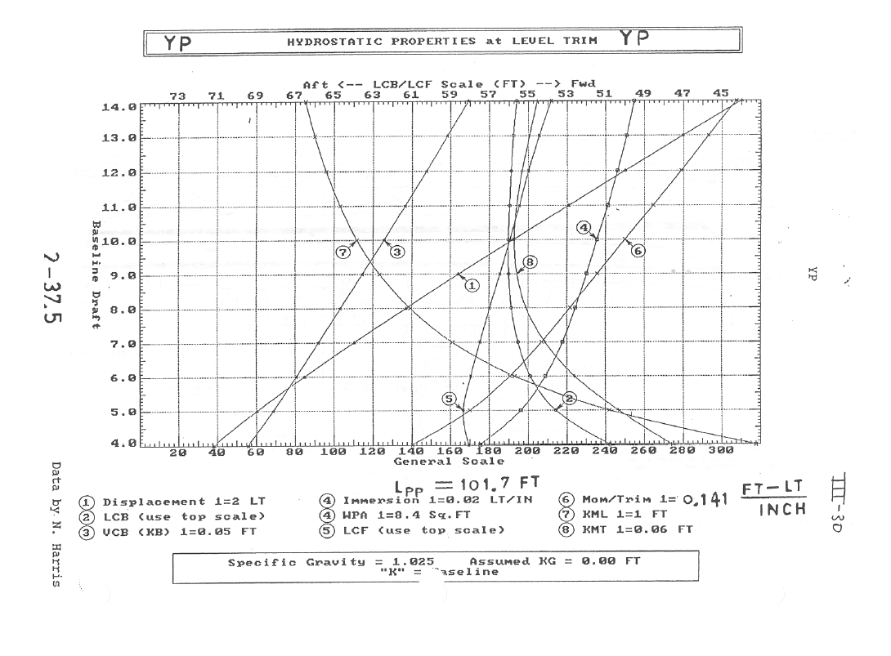

Slide 83
Curves of Forms
Displacement ( )
- assume ship is in the salt water with
- unit of displacement : long ton
1 long ton (LT) =2240 lb
LCB
- Longitudinal center of buoyancy
- Distance in feet from reference point (FP or Amidships)
VCB or KB
- Vertical center of buoyancy
- Distance in feet from the Keel

Slide 84
Curves of Forms
TPI (Tons per Inch Immersion)
- TPI : tons required to obtain one inch of parallel sinkage
in salt water
- Parallel sinkage: the ship changes its forward and aft
draft by the same amount so that no change in trim occurs
- Trim : difference between forward and aft draft of ship
- Unit of TPI : LT/inch
Note: for parallel sinkage to occur, weight must be added at center of flotation (F).

Slide 85
TPI
1 inch
A_{wp} (sq. ft)
1 inch
- Assume side wall is vertical in one inch.
- TPI varies at the ship’s draft because waterplane area changes
at the draft

Slide 86
Curves of Forms
1 inch
Awp

Slide 87
Curves of Forms
Change in draft due to parallel sinkage

Slide 88
Curves of Forms
Moment/Trim 1 inch (MT1)
- MT1 : moment to change trim one inch
- The ship will rotate about the center of flotation
when a moment is applied to it.
- The moment can be produced by adding, removing or shifting
a weight some distance from F.
- Unit : LT-ft/inch
AP
FP
l
W
F
1 inch
Change in Trim due to a Weight Addition/Removal

Slide 89
Curves of Forms
- When MT1” is due to a weight shift,
l is the distance the weight was moved
- When MT1” is due to a weight removal or addition,
l is the distance from the weight to F
LCF
l
W₀
W₁
New waterline

Slide 90
Curves of Forms
- Distance in feet from the keel to the longitudinal metacenter
- Distance in feet from the keel to the transverse metacenter
M
M
B
B
K
AP
K
FP

Slide 91
Example Problem
A YP has a forward draft of 9.5 ft and an aft draft of 10.5ft. Using the YP Curves of Form, provide the following information:
Δ= _____ KM_{T}=____
WPA= _____ LCB=____
LCF= _____ VCB=____
TPI=____ KM_{L}=____
MT1”=_________

Slide 94
Example Answer
A YP has a forward draft of 9.5 ft and an aft draft of 10.5ft. Using the YP Curves of Form, provide the following information:
Δ = 192.5×2 LT = 385 LT KM_{T} = 192.5×.06 ft = 11.55 ft
WPA = 235×8.4 ft² = 1974 ft² LCB = 56 ft fm FP
LCF = 56 ft fm FP VCB = 125×.05 ft = 6.25 ft
TPI = 235×.02 LT/in = 4.7 LT/in KM_{L} = 112×1 ft = 112 ft
MT1” = 250×.141 ft-LT/in = 35.25 ft-LT/in

Slide 95
Backup Slides

Slide 96
Example Problem
A 40 foot boat has the following Table of Offsets
(Half Breadths in Feet):
What is the area of the waterplane at a draft of 4 feet?

Slide 97
Example Answer
Y
Half-Breadths at 4 Foot Waterlines
y(x)
Half-
Breadths
(Feet)
Station Spacing=dx
=40ft/4=10ft
X
0
Station
4
A_{WP}=2∫y(x)dx
∫ydx=s/3*[1y₀+4y₁+…+2y_{n-2}+4y_{n-1}+1y_{n}]
A_{WP}=2*10ft/3*[1(1.1ft)+4(5.2ft)+2(8.6ft)+4(10.1ft)+1(10.8ft)]
A_{WP}=602ft²

Slide 98
Simpson’s Rule
Simpson’s Rule is used when a standard integration technique
is too involved or not easily performed.
A curve that is not defined mathematically
A curve that is irregular and not easily defined mathematically
It is an APPROXIMATION of the true integration

Slide 99
Given an integral in the following form:
y
y = f(x)
x
Where y is a function of x, that is, y is the dependent variable defined by x, the integral can
be approximated by dividing the area under the curve into equally spaced sections, Dx, …
y
y = f(x)
Dx
…and summing the individual areas.

Slide 100
y
y = f(x)
x
Dx
Notice that:
Spacing is constant along x (the dx in the integral is the Dx here)
The value of y (the height) depends on the location on x (y is a function of x, aka y= f(x)
The area of the series of “rectangles” can be summed up
Simpson’s Rule breaks the curve into these sections and then
sums them up for total area under the curve

Slide 101
Simpson’s 1st Rule
Area = 1/3 Dx [y_{o} + 4y₁ + 2y₂+…2y _{n-2} + 4y _{n-1} + y_{n}]
where:
- n is an ODD number of stations
- Dx is the distance between stations
- y_{n} is the value of y at the given station along x
- Repeats in a pattern of 1,4,2,4,2,4,2……2,4,1
Simpson’s 2nd Rule
Area = 3/8 Dx [y_{o} + 3y₁ + 3y₂ + 2y₃ + 3y₄ +3y₅ + 2y₆ +… + 3y _{n-1} + y_{n}]
where:
- n is an EVEN number of stations
- Repeats in a pattern 1,3,3,2,3,3,2,3,3,2,……2,3,3,1
Simpson’s 1st Rule is the one we use here since it gives an EVEN
number of divisions

Slide 102
Here’s how it’s put to use in this course:
Waterplane Area, A_{wp}
A_{wp} = 2 x 1/3 Dx [y_{o} + 4y₁ + 2y₂+…2y _{n-2} + 4y _{n-1} + y_{n}]
The “2” is needed because the data you’ll have is for a half-section…
Section Area, A_{sect}
A_{sect} = 2 x 1/3 Dx [y_{o} + 4y₁ + 2y₂+…2y _{n-2} + 4y _{n-1} + y_{n}]
Note: You will always know the value of y for the stations (x or z)!
It will be presented in the Table of Offsets or readily measured…

Slide 103
Simpson’s 1st Rule
- Uses 3 data points
- Assume 2nd order polynomial curve
Mathematical Integration
Numerical Integration
y
y
dx
y(x)=ax²+bx+c
y1
y2
y3
A
dA
A
x
x
s
s
x1
x2
x3
x1
x2
x3
Area :

Slide 104
Simpson’s 1st Rule
y
y7
y6
y8
y2
y5
y9
y1
y3
y4
s
s
x
x1
x2
x3
x4
x5
x6
x7
x8
x9
Odd number
Gen. Eqn.

Slide 105
We can now move onto the next dimension, VOLUMES!
Volume, Submerged, V_{submerged}
- It gets a little trickier here… remember, since you are now dealing with a VOLUME, the y term previous now becomes an AREA term for that station section because you are summing the areas:
V_{sub} = 1/3 Dx [A_{o} + 4A₁ + 2A₂+…2A _{n-2} + 4A _{n-1} + A_{n}]

Slide 106
Simpson’s 2nd Rule
- uses 4 data points
- assumes 3rd order polynomial curve
y
y4
y2
y3
y1
y(x)=ax³+bx²+cx+d
A
x
s
s
x4
x1
x2
x3
Area :

Slide 107
Longitudinal Center of Flotation, LCF
This is the CENTROID of the A_{wp} of the ship.
For this reason you now need to introduce the distance, x, of the section Dx from the y-axis
y
dA
y(x)
x
AP
Dx
FP
That is, LCF is the sum of all the areas, dA, and their distances from
the y-axis, divided by the total area of the water plane…

Slide 108
Longitudinal Center of Flotation, LCF, (cont’d)
Since our sectional areas are done in half-sections this needs to be multiplied by 2
Remember, dA = y(x)dx, so we can substitute for dA
A_{wp} is constant, so it moves left
dA
LCF =2/A_{wp}
x dA
2/A_{wp}
x y(x)dx
Substituting into Simpson's Eq., you’ll get the following:
LCF = 2/A_{wp} x 1/3 Dx [(1) (x_{o}) (y_{o}) + 4 (x₁) (y₁) + 2 (x₂) (y₂) +… + (x_{n}) (y_{n}) ]
Note that the blue terms are what we have to add to make Simpson work for LCF.
Remember to include them in your calculations!

